Slide 1
Welcome Snuffles
Byte Academy
June 2016

Slide 2
Snuffles

Slide 3
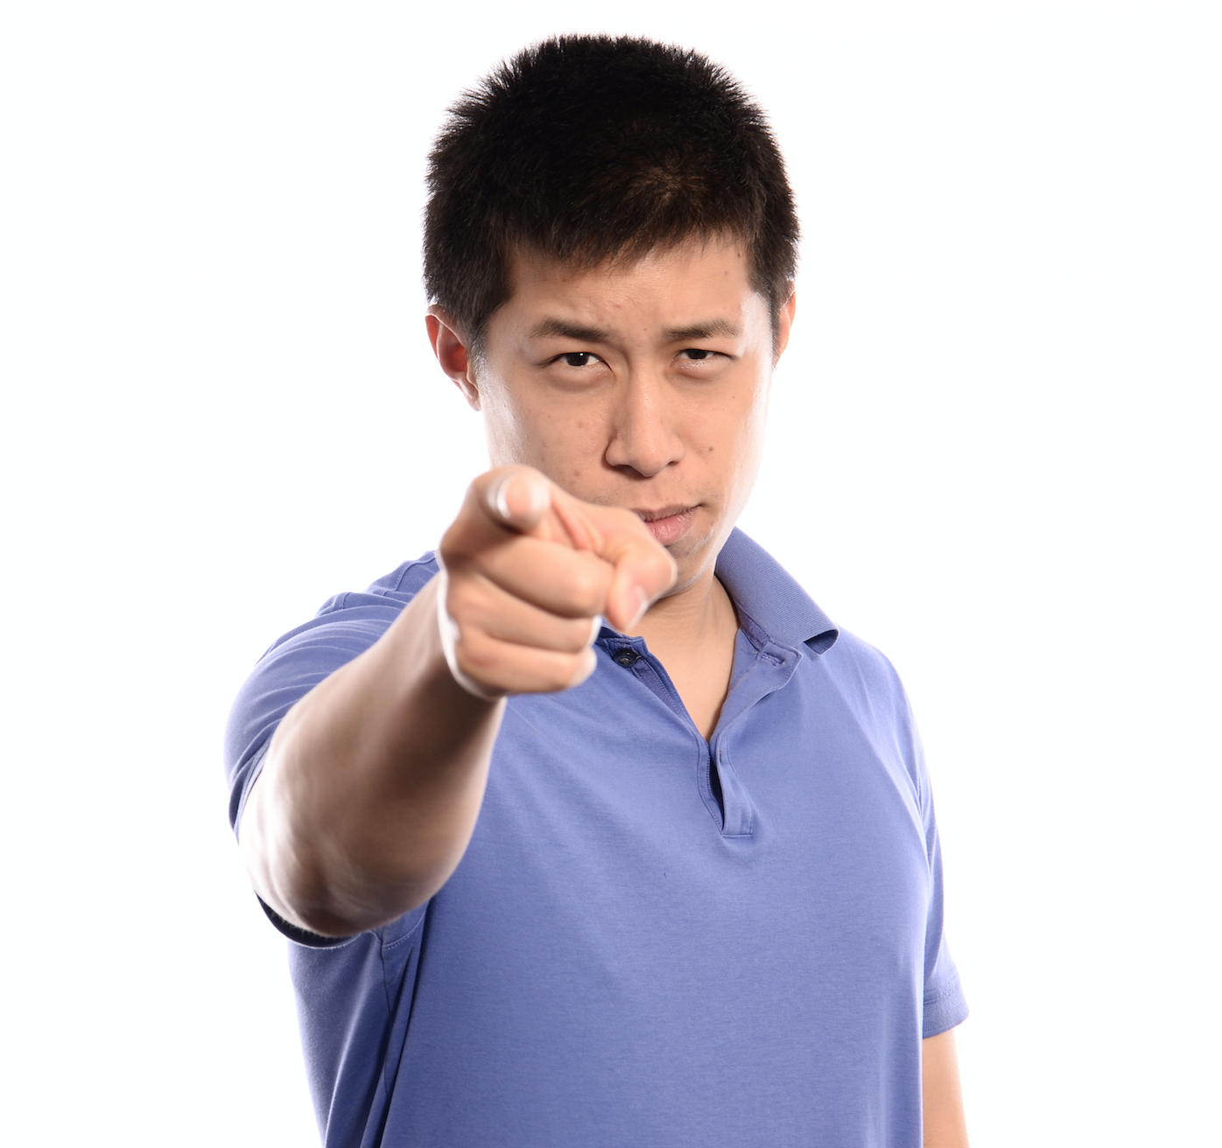
Your Instructional Team
Jason Ng
Team: Snuffles
TBD
Team: Bisons
Thomas Harvey
Team: Gila-Monsters
William Mantly
Instructional Lead

Slide 4
Snowball Fight
Take two pieces of paper
One – Write something that makes you excited to start here
Example: “I’m excited to learn more about CSS, because I want to make websites beautiful”
Two – Write something that makes you nervous to start here
Example: “I’m nervous that I won’t be able to solve a problem without help”

Slide 5
Who Are You?
Introduce yourself
What is your name?
What did you do before this?
Why did you choose to learn programming?
You’ve been exiled to a deserted island for one year. In addition to essentials you may take one piece of music, one book (not the Bible), and one luxury item that you can carry. (cannot be a boat…). What do you take and why?

Slide 6
Your Learning Experience

Slide 7
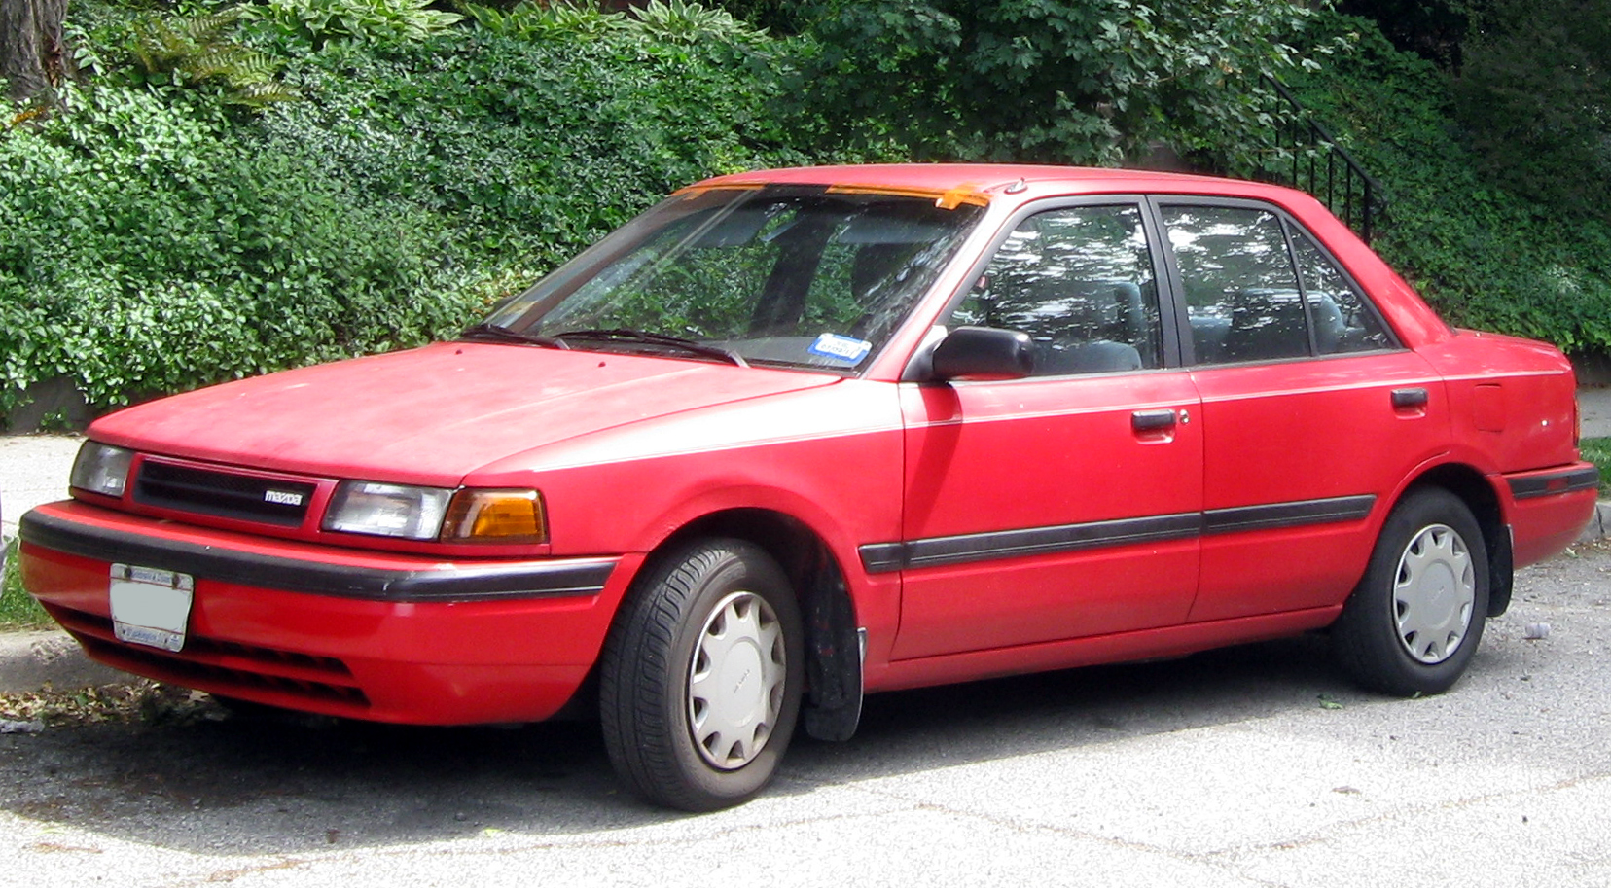
Notes:
Abstraction
There is a lot of material
Don’t go into a black hole of needing to know the inner workings of everything
Our job is to streamline your education efficiently

Slide 8
Pseudo Learning Experience
Work together for the next ten minutes (groups of three/four)
Write down how you would prepare to complete the below tasks
Not asking for “measurements” or a “daily schedule breakdown”
Discuss the process of how you would go about accomplishing these tasks as a team
Group A - Complete an IronMan Triathlon
Group B – Climb Mount Everest
Group C – Move to a country you have never been and do not speak the language.

Slide 9
Groups!
Group A
Group B
Group C

Slide 10
Processes and Answers
Account for different backgrounds
What does growth look like
How do you define success
Team Dynamic
Personal Trainers / Coaches
Teachers / Guides
Videos / Classes
Practice
Notes:
This is a team effort

Slide 11
BREAK!

Slide 12
Your Immersive experience
The end goal is to teach you how to teach yourself
Your schedule and resources
10 a.m. – 6 p.m. Monday through Friday (Immersion Hours)
Lectures will be held in the morning for 1-2 hours
90 minute lunch break
Afternoons will be spent programming and pair programming
Instructors and TA’s will be here to help you with assignments during the day. After 6pm and on weekends they can be reached on Slack . There are no guarantees how accessible instructors will be outside of immersion hours.
You are welcomed and encouraged to stay here and continue working together after 6pm and on weekends.
Github – All lessons and assignments will be posted here.
Jeffity – Online discussion forum written by Jeff Maxim
Notes:
Please put in the time outside of Immersion Hours

Slide 13
Some Ground Rules
Be respectful of each other
Leave your ego at the door
Positive criticisms
Noise Level
Classes / Events / Workshops / Phone Calls
Your Workspace
Please keep it clean
Do not keep expensive things here/openly overnight
Be careful of open containers

Slide 14
Advice For Success!

Slide 16
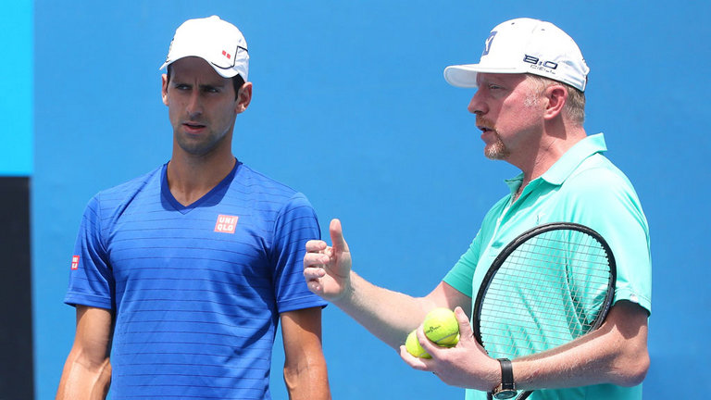
Be open to coaching

Slide 17
Have a plan to get unstuck
Work on it for 15 minutes.
You solved it! 2. You didn’t figure it out.
Now, you’ve got to do something. Some options:
“Rubber duck” it
Post your question on Jeffity
Take a break and work on something else
Ask a classmate
Ask an Instructor / TA
Celebrate!

Slide 18

Take Care Of Yourself

Slide 19
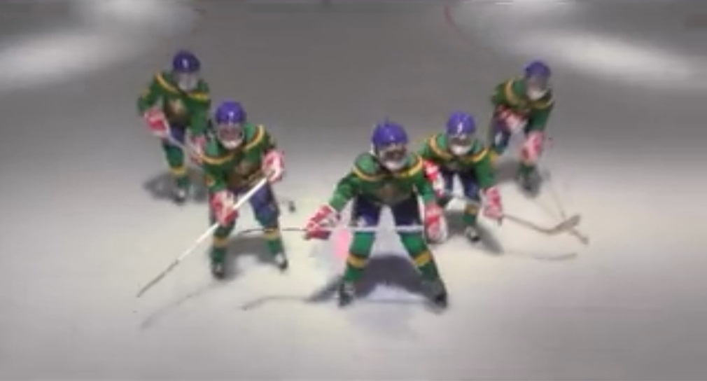
Take Care of Each Other

Slide 20
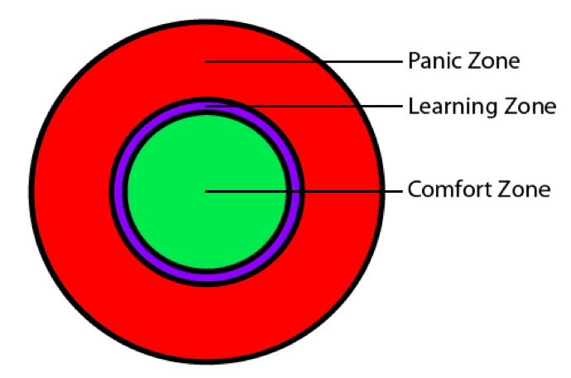
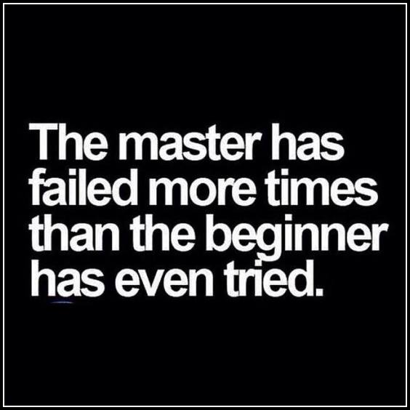
Enjoy the struggle
Your byte academy goal: teach you to teach yourself ← you learn that by failing. a lot.

